Slide 1
Cornerstone City Church Peninsula Plus Community Hoo Are Ya
11th February 2024

Slide 2


Slide 3


Slide 4
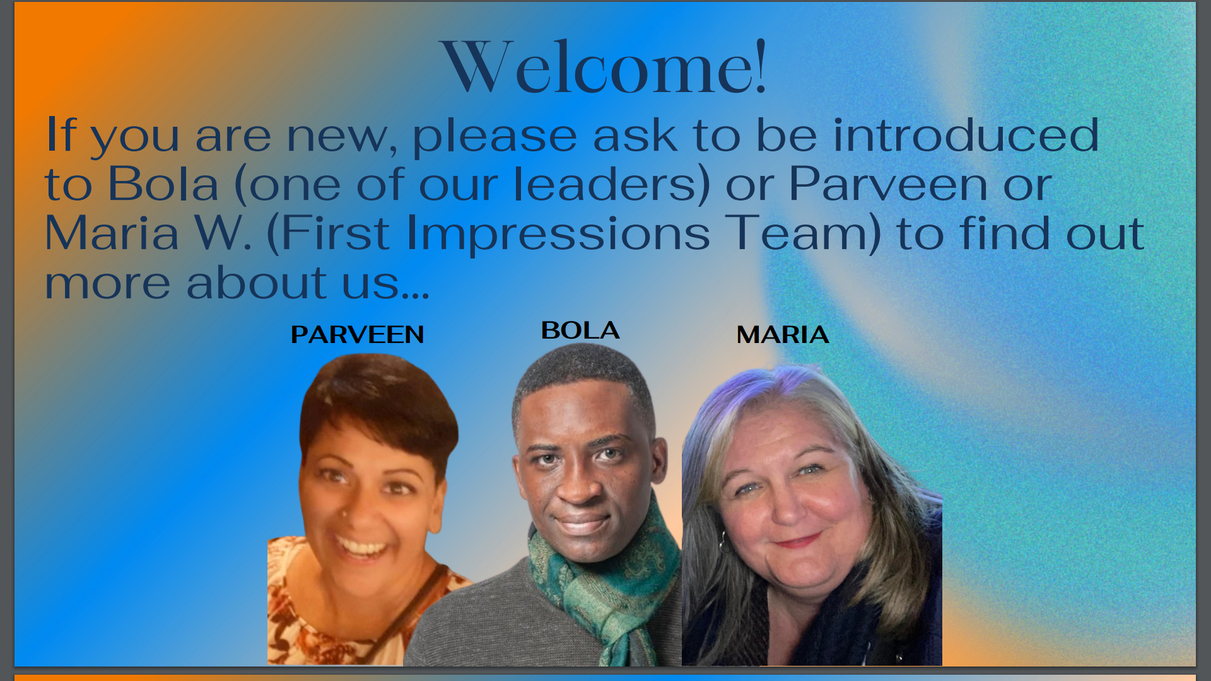

Slide 5


Slide 6
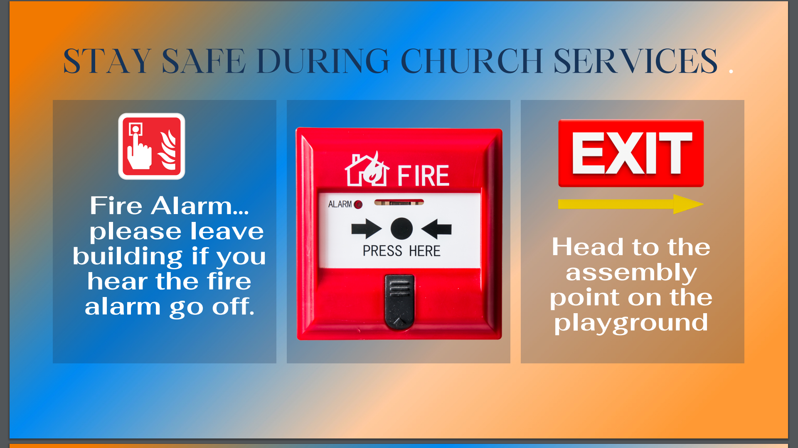

Slide 7


Slide 8


Slide 9


Slide 10
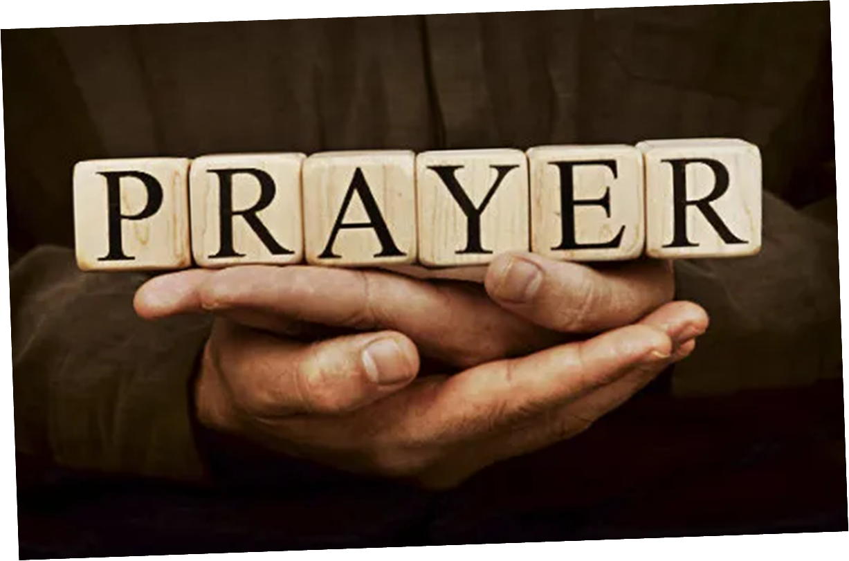

Slide 11


Slide 12
Great Big God
CCLI Song # 3373437
Jo Hemming | Nigel Hemming
© 2001 Vineyard Songs (UK/Eire) (Admin. by Integrity Music Ltd)
For use solely with the SongSelect® Terms of Use. All rights reserved. www.ccli.com
CCLI Licence No. 33265

Slide 13
1/2
Our God is a great big God
Our God is a great big God
Our God is a great big God
And He holds us in His hands

Slide 14
2/2
He's higher than a skyscraper
And He's deeper than a submarine
He's wider than the universe
And beyond my wildest dreams
And He's known me and He's loved me
Since before the world began
How wonderful to be a part of
God's amazing plan

Slide 15
Open The Eyes of My Heart
CCLI Song # 2298355
Paul Baloche
© 1997 Integrity's Hosanna! Music (Admin. by Integrity Music Ltd)
For use solely with the SongSelect® Terms of Use. All rights reserved. www.ccli.com
CCLI Licence No. 33265

Slide 16
1/3
Open the eyes of my heart Lord
Open the eyes of my heart
I want to see You
I want to see You

Slide 17
2/3
To see You high and lifted up
Shining in the light of Your glory
Pour out Your power and love
As we sing holy holy holy

Slide 18
3/3
Holy holy holy
Holy holy holy
Holy holy holy
I want to see You

Slide 19
Great Are You Lord
CCLI Song # 6460220
David Leonard | Jason Ingram | Leslie Jordan
© 2012 Open Hands Music (Admin. by Essential Music Publishing LLC)
So Essential Tunes (Admin. by Essential Music Publishing LLC)
Integrity's Praise! Music (Admin. by Integrity Music Ltd)
Little Way Creative (Admin. by Integrity Music Ltd)
For use solely with the SongSelect® Terms of Use. All rights reserved. www.ccli.com
CCLI Licence No. 33265

Slide 20
1/3
You give life You are love
You bring light to the darkness
You give hope You restore ev'ry heart that is broken
And great are You Lord

Slide 21
2/3
It's Your breath in our lungs
So we pour out our praise
We pour out our praise
It's Your breath in our lungs
So we pour out our praise to You only

Slide 22
3/3
And all the earth will shout Your praise
Our hearts will cry these bones will sing
Great are You Lord
(REPEAT)

Slide 24
Raise A Hallelujah
CCLI Song # 7119315
Jake Stevens | Jonathan David Helser | Melissa Helser | Molly Skaggs
© 2018 Bethel Music Publishing (Admin. by Song Solutions)
For use solely with the SongSelect® Terms of Use. All rights reserved. www.ccli.com
CCLI Licence No. 33265

Slide 25
1/7
I raise a hallelujah in the presence of my enemies I raise a hallelujah louder than the unbelief I raise a hallelujah my weapon is a melody I raise a hallelujah Heaven comes to fight for me

Slide 26
2/7
I’m gonna sing in the middle of the storm Louder and louder you’re gonna hear my praises roar Up from the ashes hope will arise Death is defeated the King is alive

Slide 27
3/7
I raise a hallelujah with everything inside of me I raise a hallelujah I will watch the darkness flee I raise a hallelujah in the middle of the mystery I raise a hallelujah fear you lost your hold on me

Slide 28
4/7
Sing a little louder (Sing a little louder) Sing a little louder (Sing a little louder)

Slide 29
5/7
Sing a little louder in the presence of my enemies Sing a little louder louder than the unbelief Sing a little louder my weapon is a melody Sing a little louder Heaven comes to fight for me

Slide 30
6/7
I’m gonna sing in the middle of the storm Louder and louder you’re gonna hear my praises roar Up from the ashes hope will arise Death is defeated the King is alive

Slide 31
7/7
I raise a hallelujah in the presence of my enemies I raise a hallelujah louder than the unbelief I raise a hallelujah my weapon is a melody I raise a hallelujah Heaven comes to fight for me

Slide 33
Good Good Father
CCLI Song # 7036612
Anthony Brown | Pat Barrett
© 2014 Capitol CMG Paragon (Admin. by Capitol CMG Publishing)
Common Hymnal Digital (Admin. by Capitol CMG Publishing)
Housefires Sounds (Admin. by Capitol CMG Publishing)
Rising Springs Music (Admin. by Capitol CMG Publishing)
Tony Brown Publishing Designee (Admin. by Capitol CMG Publishing)
Vamos Publishing (Admin. by Capitol CMG Publishing)
worshiptogether.com songs (Admin. by Capitol CMG Publishing)
For use solely with the SongSelect® Terms of Use. All rights reserved. www.ccli.com
CCLI Licence No. 33265

Slide 34
1/5
I've heard a thousand stories
Of what they think You’re like
But I've heard the tender whisper
Of love in the dead of night
You tell me that You’re pleased
And that I'm never alone

Slide 35
2/5
You're a Good Good Father
It's who You are
It's who You are
It's who You are
And I'm loved by You
It's who I am
It's who I am
It's who I am

Slide 36
3/5
I've seen many searching for answers
Far and wide
But I know we're all searching for answers
Only You provide
Because You know just what we need
Before we say a word

Slide 37
4/5
You are perfect in all of Your ways
You are perfect in all of Your ways
You are perfect in all of Your ways to us

Slide 38
5/5
Love so undeniable I can hardly speak
Peace so unexplainable I can hardly think
As You call me deeper still
As You call me deeper still
As You call me deeper still
Into love love love

Slide 40


Slide 41
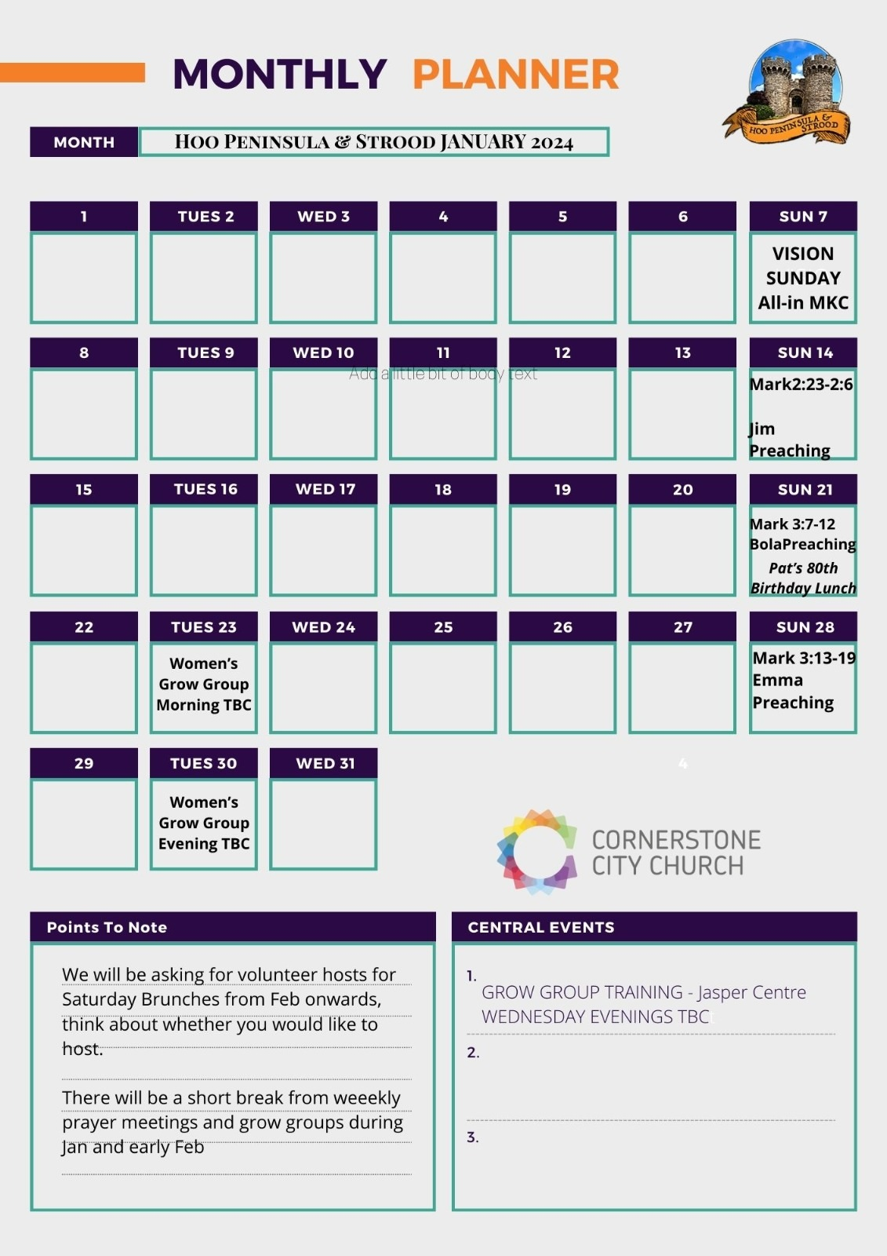

Slide 42


Slide 44
2 Corinthians 14 May the grace of the Lord Jesus Christ, and the love of God, and the fellowship of the Holy Spirit be with you all

